Slide 1
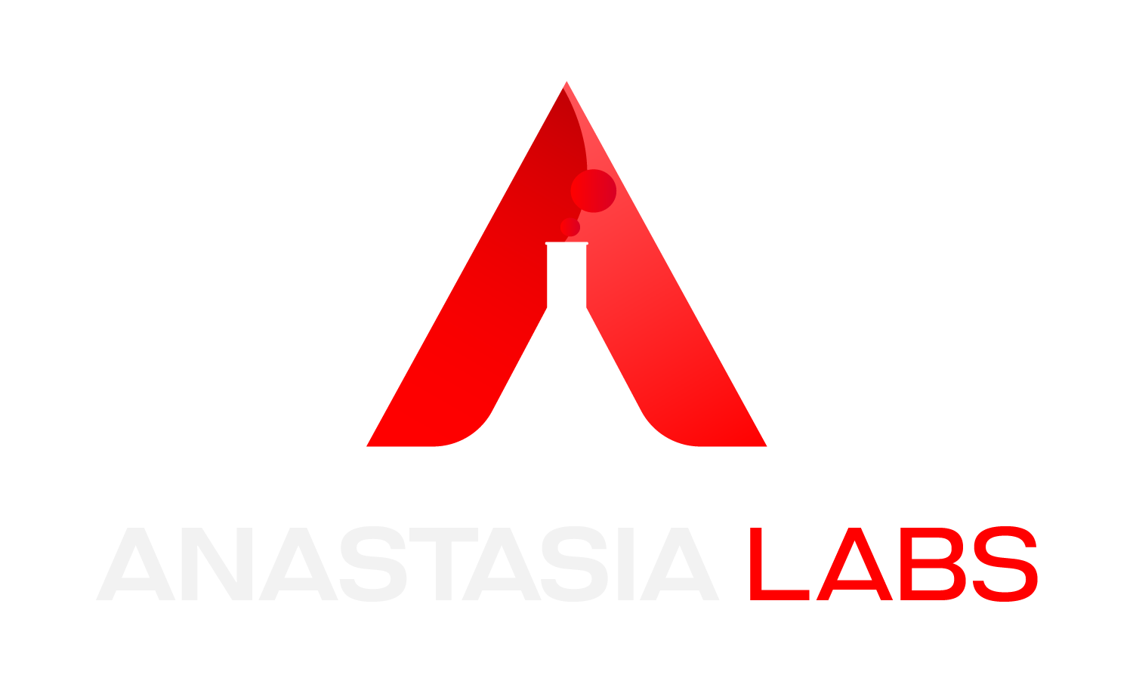

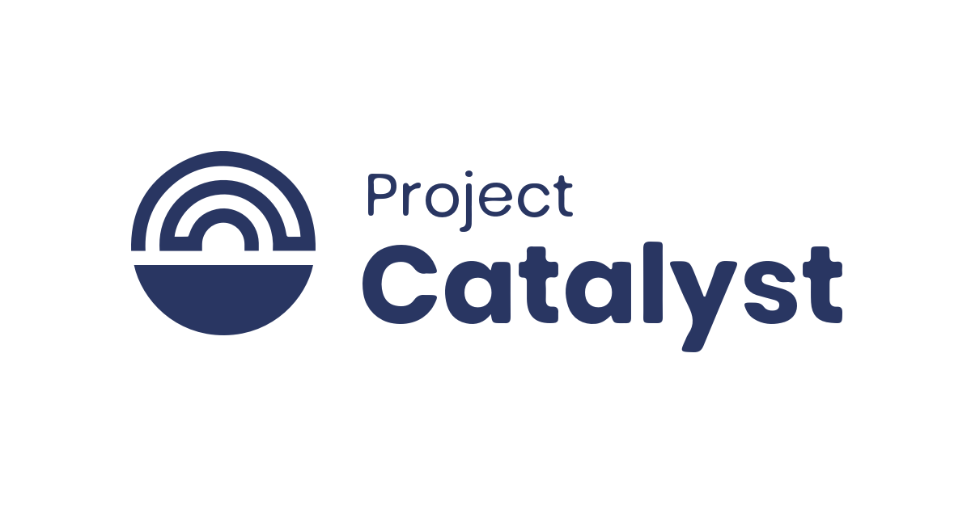
Fund 10

Slide 2
Plug-and-play Smart Contract API: A game-changing platform to deploy open-source contracts instantly

Slide 3
Challenge
To Increase Developer Adoption and Ecosystem Growth To drive developer adoption and ensure ecosystem growth by addressing the limited availability of smart contract deployment by providing simplified integration and deployment processes for developers without deep blockchain expertise.
To Simplify Smart Contract Development by tackling the complexity and time consuming nature of building secure and reliable smart contracts due to insufficient security expertise and practical resources.

Slide 4
Project Objectives
To design and develop comprehensive library of secure and reusable Smart Contracts.
Single Asset Staking
Linear Vesting
Direct Offer

Slide 5
Project Objectives (Cont’d)
To ensure these contracts go through rigorous testing and are production-ready.
To deliver ready-to-use Smart Contract APIs, along with comprehensive documentation and user-friendly tutorials.

Slide 6
Execution and Milestones
We divided our project into five phases.
Design and Development
Preparation Phase: Off-Chain SDKs Building
Integration Phase: Smart Contract API Integration
Testing Phase: Smart Contract API Testing
Documentation and Community Engagement

Slide 7
Phase 1: Design and Development
We successfully designed and developed three essential Smart Contracts in Plutatch.
Single Asset Staking: To enable users to collectively stake digital assets and distribute rewards fairly
Linear Vesting Contract: To provide secure and customizable mechanisms for gradual asset release.
Direct Offer Contract: To facilitate peer-to-peer trading of assets.

Slide 8
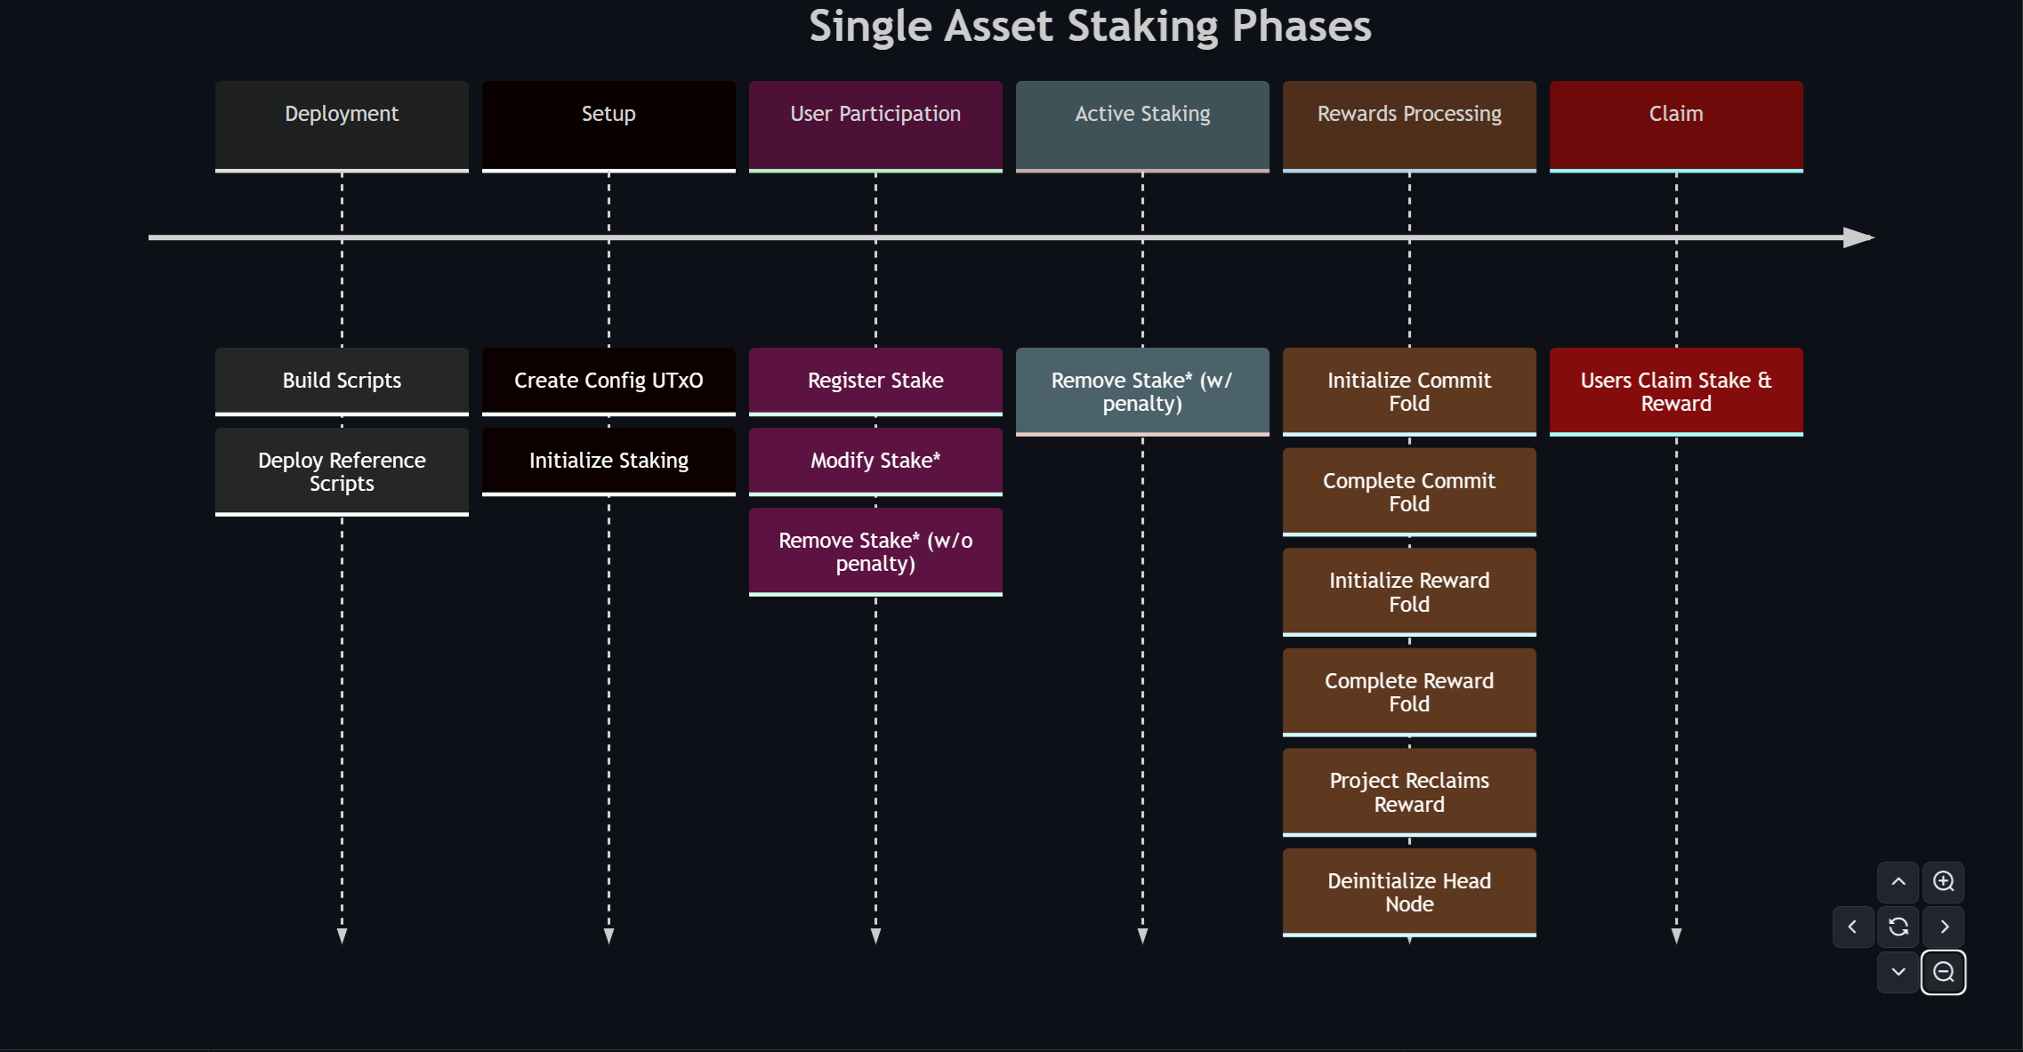
Single Asset Staking
This enables users to collectively stake digital assets and distribute rewards fairly in a completely on-chain and trustless manner.

Slide 9
Linear Vesting Contract
This contract aims at providing a reliable mechanism for releasing Cardano Native Tokens gradually over a specified timeframe, with customisation options to fit different requirements.

Slide 10
Direct Offer Contract
This project provides a plutarch based implementation of a smart contract enabling peer-to-peer trading, in a trustless manner, for the Cardano Blockchain.

Slide 11
Phase 2: Off-Chain SDK Building
We built and made available SDKs for each of the Smart Contracts, simplifying the integration process for the Maestro team.

Slide 12
Phase 3: Smart Contract API Integration
In collaboration with Maestro, we integrated our Smart Contracts into a fully managed service, enabling developers to interact with them via APIs.

Slide 13
Phase 4: Smart Contract API Testing
We conducted rigorous testing for each contract to ensure they meet the highest standards of reliability and performance.

Slide 14
Phase 5: Documentation
We created user-friendly documentation to help developers of all skill levels understand and implement the APIs. Our documentation includes detailed guides, practical examples, diagrams, step by step instructions and tutorials.

Slide 15
Single Asset Staking: Execution Demo

Slide 16
Single Asset Staking: Resources
Detailed guides and practical examples can be found at:
Contract: https://github.com/Anastasia-Labs/single-asset-staking
SDK: https://github.com/Anastasia-Labs/single-asset-staking-offchain
APIs: https://docs.gomaestro.org/single-asset-staking-1

Slide 17
Linear Vesting Contract: Execution Demo

Slide 18
Linear Vesting: Resources
Detailed guides and practical examples can be found at:
Contract: https://github.com/Anastasia-Labs/linear-vesting
SDK: https://github.com/Anastasia-Labs/linear-vesting-offchain
APIs: https://docs.gomaestro.org/linear-vesting-1

Slide 19
Direct Offer Contract: Execution Demo

Slide 20
Direct Offer: Resources
Detailed guides and practical examples can be found at:
Contract: https://github.com/Anastasia-Labs/direct-offer
SDK: https://github.com/Anastasia-Labs/direct-offer-offchain
APIs: https://docs.gomaestro.org/direct-swap-1

Slide 21
Achievements
Implementation of secure, modular and reusable APIs for the Single Asset Staking, Linear Vesting and Direct Offer Contract.
Quality Assuarance through conducting rigorous code reviews and comprehensive unit tests.
Seamless Integration With Maestro.

Slide 22
Achievements (Cont’d)
Extensive documentation and Tutorials to help developers quickly understand and implement our solutions
Industry Collaborations and Community Engagement at the 2023 Dubai Summit.
Accessibility via Demeter

Slide 23
Key Learnings and Challenges
Effectiveness of Modular Design and Security.
Importance of simplifying the integration process.
The importance of balancing customization and standardization
The value in comprehensive documentation and monitoring.

Slide 24
Future Prospects & Community Impact
Expand Smart Contract Library.
Enhance API Documentation.
Optimize Performance and Scalability.
Collaboration with Ecosystem Partners.
Continuous Feedback.
Long Term Commitment.

Slide 25
Conclusion
The project has developed and deployed secure, modular and reusable smart contracts with comprehensive off-chain SDKs, APIs and extensive documentation.
Added to the arsenal of tools that enhance the capabilities of DApps on Cardano.

Slide 26
Links
Plug-n-Play: https://github.com/Anastasia-Labs/plug-n-play-contracts
Anastasia Labs: https://anastasialabs.com
Maestro: https://www.gomaestro.org/smart-contracts
Twitter / X: https://x.com/AnastasiaLabs
Discord: https://discord.com/invite/8TYSgwthVy

Slide 27
Thank You!

